Slide 1
ShopMee: A Modern Full-Stack E-Commerce Solution
Welcome to the future of e-commerce. ShopMee offers a robust, scalable, and intuitive platform designed to revolutionize the online retail experience. Discover how our cutting-edge technology empowers businesses and enhances user experiences.
Dhakshaya GM

Slide 2
Project Overview
ShopMee is designed as a comprehensive, full-stack e-commerce platform, meticulously engineered to provide a seamless online shopping experience from product browsing to order fulfillment. Our architecture ensures robust performance and scalability.
Full-Stack E-commerce
Core Technologies
A complete solution covering both user-facing and backend operations for comprehensive online retail management.
Built with React for dynamic UIs, Node.js for scalable server-side logic, and PostgreSQL for reliable data storage.
Three-Tier Architecture
Dual Interface Support
Clear separation of Presentation, Business Logic, and Data layers for enhanced maintainability and scalability.
Dedicated interfaces for both customers for shopping and administrators for efficient platform management.

Slide 3
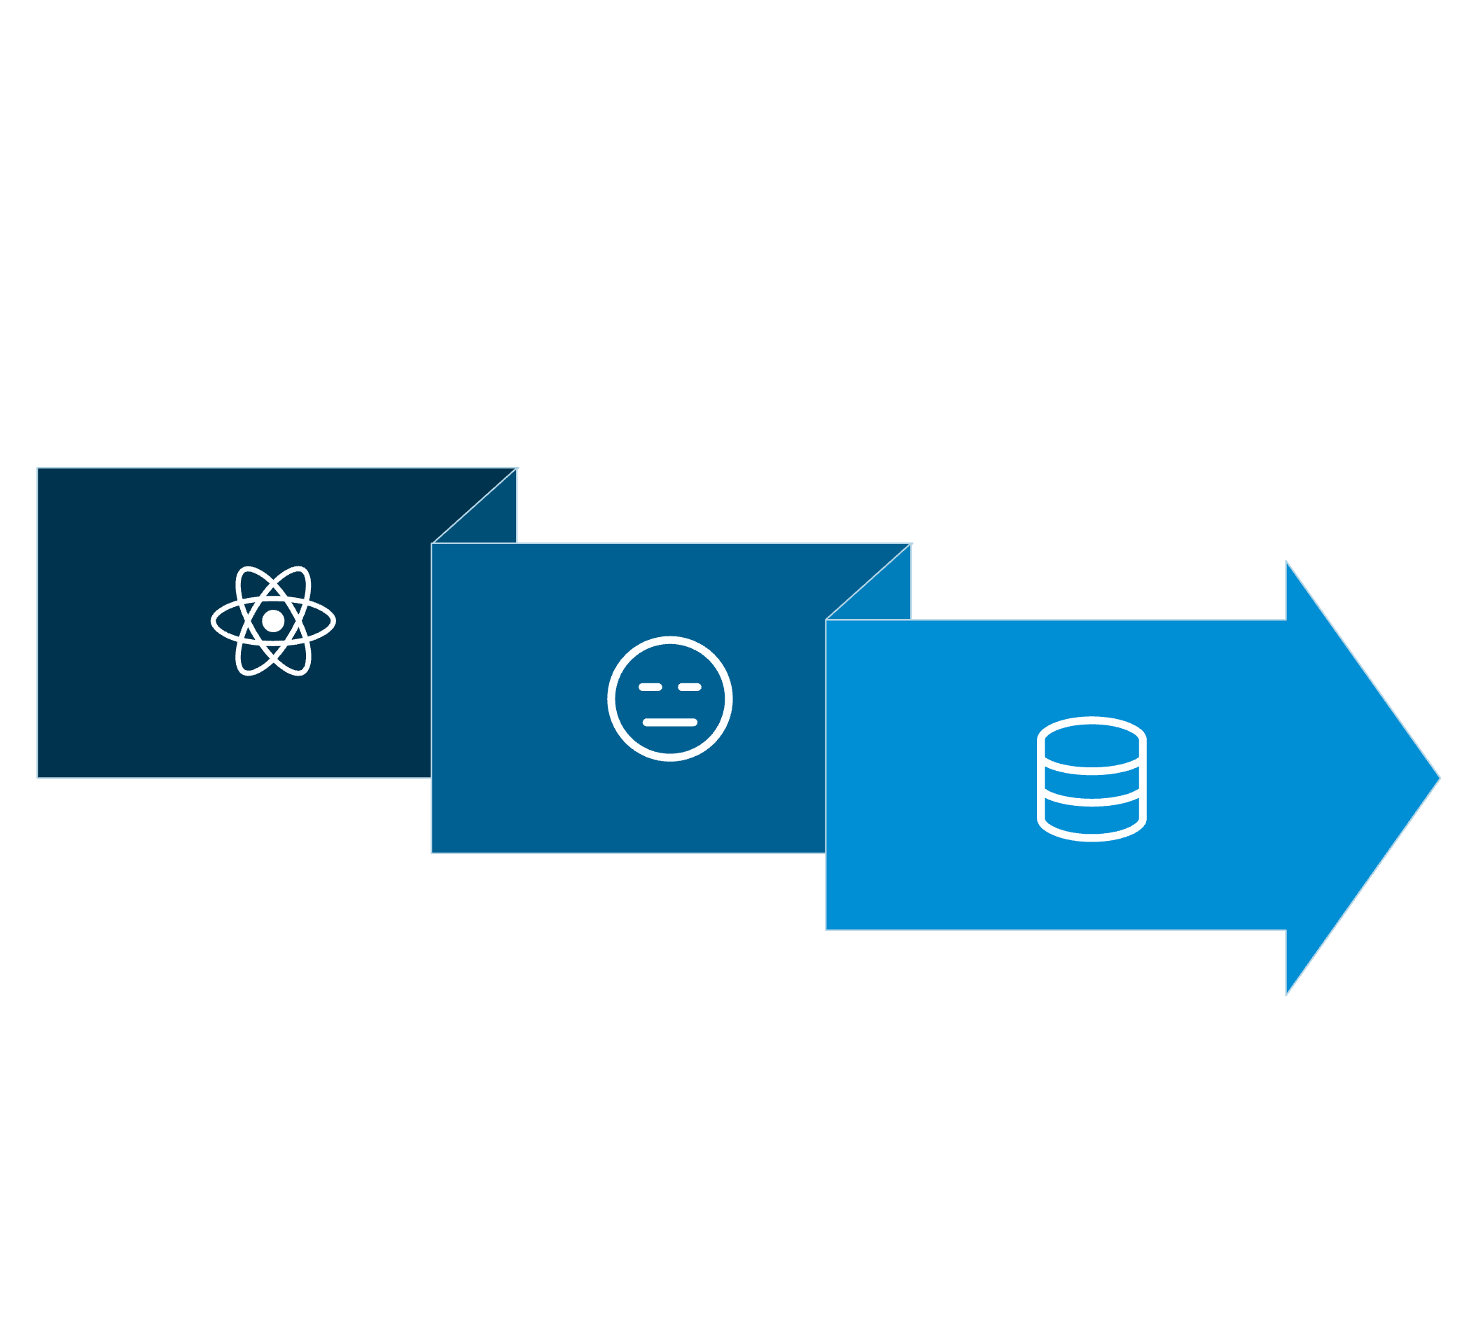
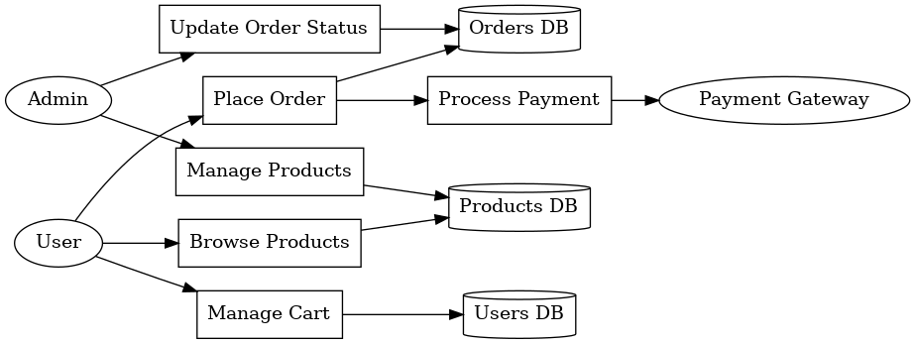
System Architecture
Our system follows a modular design, ensuring clear separation of concerns and efficient data flow across all layers.
Client
Data & Services
API Gateway
API Gateway Layer: An Express.js server managing routes, middleware, and controllers for secure and efficient request handling.
Data Layer: PostgreSQL for core database operations, Cloudinary for image storage, and integrated payment gateways like Stripe and Razorpay.
Client Layer: User interfaces built with React for the frontend, admin panel, and responsive mobile web experiences.

Slide 4
Technology Stack
ShopMee leverages a modern, robust technology stack to deliver high performance, security, and a seamless user experience across all modules.
Frontend
Backend
External Services
React 19: For dynamic and responsive user interfaces.
Node.js: For server-side JavaScript runtime.
Cloudinary: Cloud-based image management.
React Router: For declarative routing.
Express.js: For a robust web application framework.
Stripe: Secure payment processing.
Tailwind CSS: For rapid UI development.
Razorpay: Alternative payment gateway.
Axios: For promise-based HTTP client.
Sequelize: ORM for PostgreSQL interaction.
Vercel: For frontend deployment.
React Toastify: For notification messages.
Railway/Render: For backend and database hosting.
PostgreSQL: Reliable relational database.
Vite: For fast development build tool.
JWT: For secure user authentication.
bcrypt: For password hashing.
Multer: For handling file uploads.
CORS: For cross-origin resource sharing.

Slide 5



Key Features
ShopMee is packed with essential features designed to support a full-fledged e-commerce operation, from user management to comprehensive order handling and secure payments.
Authentication & Authorization
Product & Cart Management
Payment Integration
Seamless transactions via Stripe and Razorpay.
Secure JWT-based system for user login and access control.
Intuitive browsing, search, and full shopping cart functionality.
Admin Dashboard
Responsive Design
Centralized control for products, orders, and users.
Optimized for a consistent experience across all devices.

Slide 6
Component Architecture
Our component-based architecture ensures modularity and reusability, simplifying development and maintenance across both frontend and backend systems.
Frontend
Backend
Core Components: Reusable UI elements like Navbar, Footer, SearchBar, BestSeller, CartTotal for consistent design.
Controllers: Handles request logic with userController, productController, cartController, and orderController for specific resource management.
Dedicated Pages: Specific views for Home, Collection, Product, Cart, Login, PlaceOrder, and Orders to guide user journeys.
Models: Defines database schemas and interactions through userModel, productModel, and orderModel for data integrity.
State Management: Utilizes React Context API for global state and Local Storage for persistent client-side data, ensuring smooth user interactions.
Middleware: Implements functions like auth, adminAuth, and multer for secure access control and efficient file handling before requests reach controllers.

Slide 7
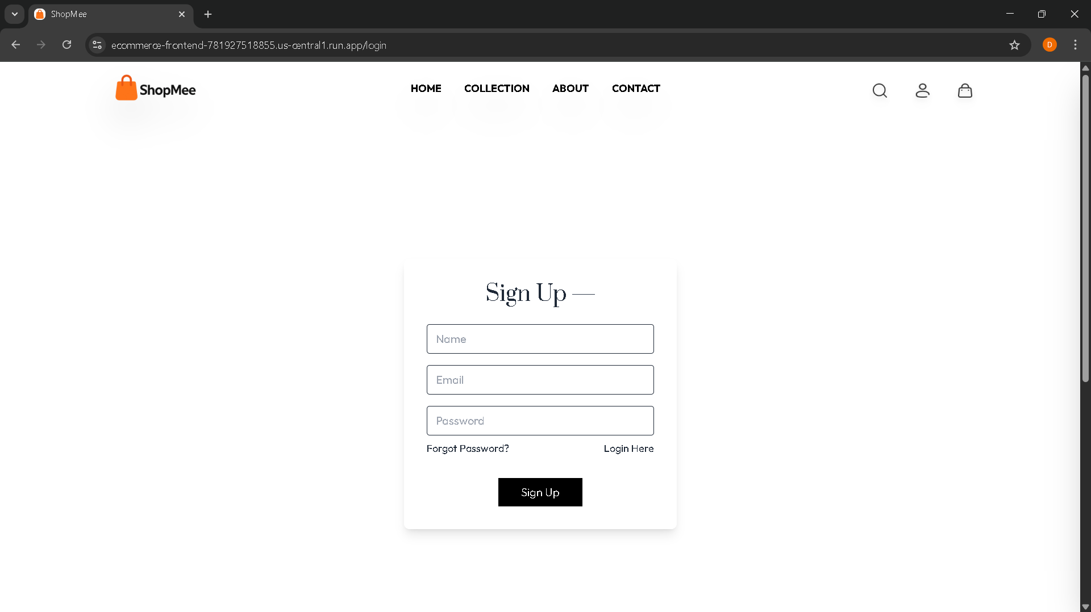
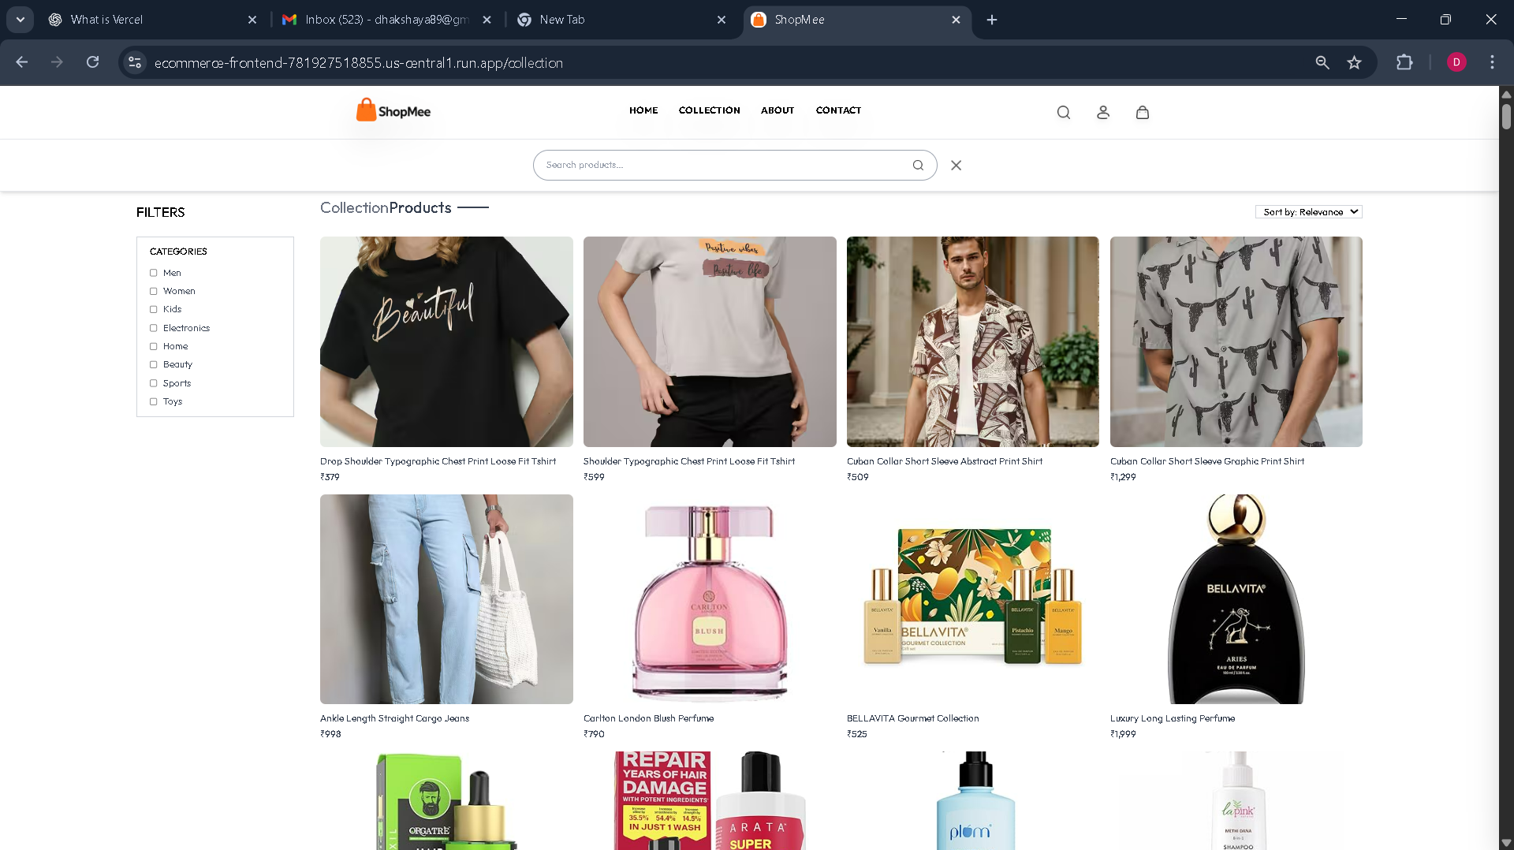


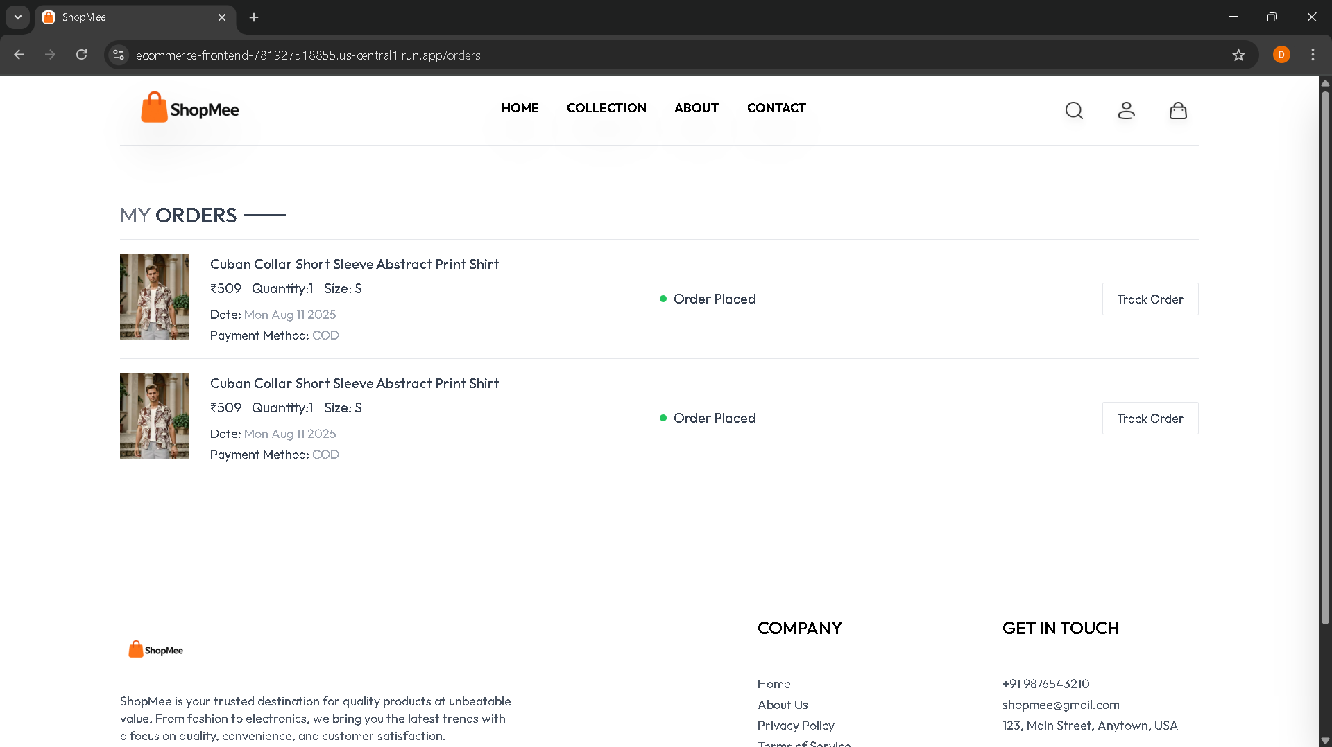

Data Flow Architecture
ShopMee’s data flow is meticulously designed for efficiency and security, ensuring smooth interactions from user input to database operations and back.
User Authentication
User submits credentials, frontend sends to backend, backend verifies against database and issues a secure JWT token.
Product Browsing
User requests products, frontend fetches from backend, backend queries database, and products are returned for display.
Order Processing
User places an order, backend validates data, creates the order entry, processes payment through integrated gateways, and updates order status.

Slide 8
Deployment Infrastructure
Our deployment strategy leverages Google Cloud's serverless and managed services to ensure scalability, security, and operational efficiency for ShopMee's e-commerce ecosystem.
1
2
3
Backend Services on Cloud Run
Frontend & Admin Dashboards
Cloud SQL (PostgreSQL) Database
Our Node.js/Express backend is containerized with Docker and deployed to Google Cloud Run, enabling auto-scaling and simplified management. Secure communication with Cloud SQL is established via Unix domain sockets using the INSTANCE_CONNECTION_NAME environment variable, enhancing security and reducing latency. Critical configurations, including database credentials, JWT secrets, and third-party API keys, are securely managed through Cloud Run's environment variable system. Product images are offloaded to Cloudinary for efficient media storage and delivery, reducing the load on our primary services.
Both the customer-facing React + TailwindCSS frontend and the administrative dashboard are deployed on Google Cloud Run. The frontend undergoes a rigorous build process (npm run build) before deployment, optimizing static assets for caching and ensuring a mobile-first responsive design for a seamless user experience. The admin dashboard, collocated with the frontend for centralized management, enforces secure access through JSON Web Token (JWT) based authentication, safeguarding sensitive operational controls.
Our core database runs on Google Cloud SQL with PostgreSQL, providing a managed, high-performance relational database solution. Data was seamlessly migrated from local development environments to Cloud SQL. To enhance query performance and ensure rapid data retrieval, strategic indexes have been applied to frequently accessed tables. All connections from Cloud Run services to the database are secured using the integrated socket connection method, preventing direct public exposure of the database instance and minimizing attack surfaces.

Slide 9
Database Design
The PostgreSQL database is structured to efficiently manage core e-commerce entities, ensuring data integrity and fast retrieval for all operations.
Users
id, name, email, password, cartData (JSON)
Products
id, name, description, price, category, subCategory, bestseller, date, images (array), sizes
Orders
id, userId, amount, status, paymentMethod, payment, date, items (JSON), address (JSON)
Relationships
Users ↔ Orders (One-to-Many), Users ↔ Cart (One-to-One, managed via JSON in Users table for flexibility).
This design balances normalization with practical considerations like storing cart data as JSON for flexibility, optimizing performance for common e-commerce queries.

Slide 10

API Overview
ShopMee’s backend exposes a comprehensive RESTful API, designed for clarity, efficiency, and security, facilitating seamless interaction with frontend applications.
RESTful Principles: Resource-based URLs (`/api/user`, `/api/product`) ensure intuitive and predictable endpoint access.
Main Endpoints
/api/user/register: Create new user accounts.
JWT Authentication: All protected endpoints require a valid JSON Web Token for secure access and authorization, maintaining data integrity.
/api/user/login: Authenticate users and issue JWTs.
/api/product/list: Retrieve available product listings.
Consistent Responses: All API responses adhere to a standardized JSON format, simplifying data parsing and error handling for clients.
/api/cart/add: Add items to a user's shopping cart.
/api/order/place: Finalize orders and initiate payment processing.
This structured API design streamlines development and ensures a robust foundation for integrating with various client applications.

Slide 11
Security Architecture
Security is paramount for ShopMee. We employ multi-layered defenses to protect user data and ensure secure transactions.
Password Hashing
User passwords are securely stored as one-way hashed values using bcrypt, preventing direct access even in the event of a breach.
JWT for Authentication
JSON Web Tokens (JWT) are used for secure authentication and authorization, ensuring that only authorized users can access protected resources.
Input Validation & Sanitization
All incoming data is rigorously validated and sanitized to prevent common vulnerabilities like SQL injection and XSS attacks.
CORS Configuration
Cross-Origin Resource Sharing (CORS) is strictly configured to only allow requests from authorized origins, enhancing security.
Robust Error Handling
Comprehensive error handling middleware is implemented to gracefully manage exceptions and prevent sensitive information leakage.

Slide 12
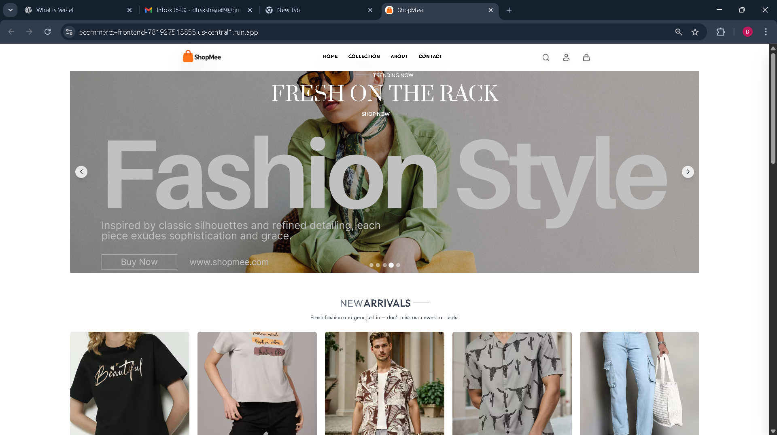
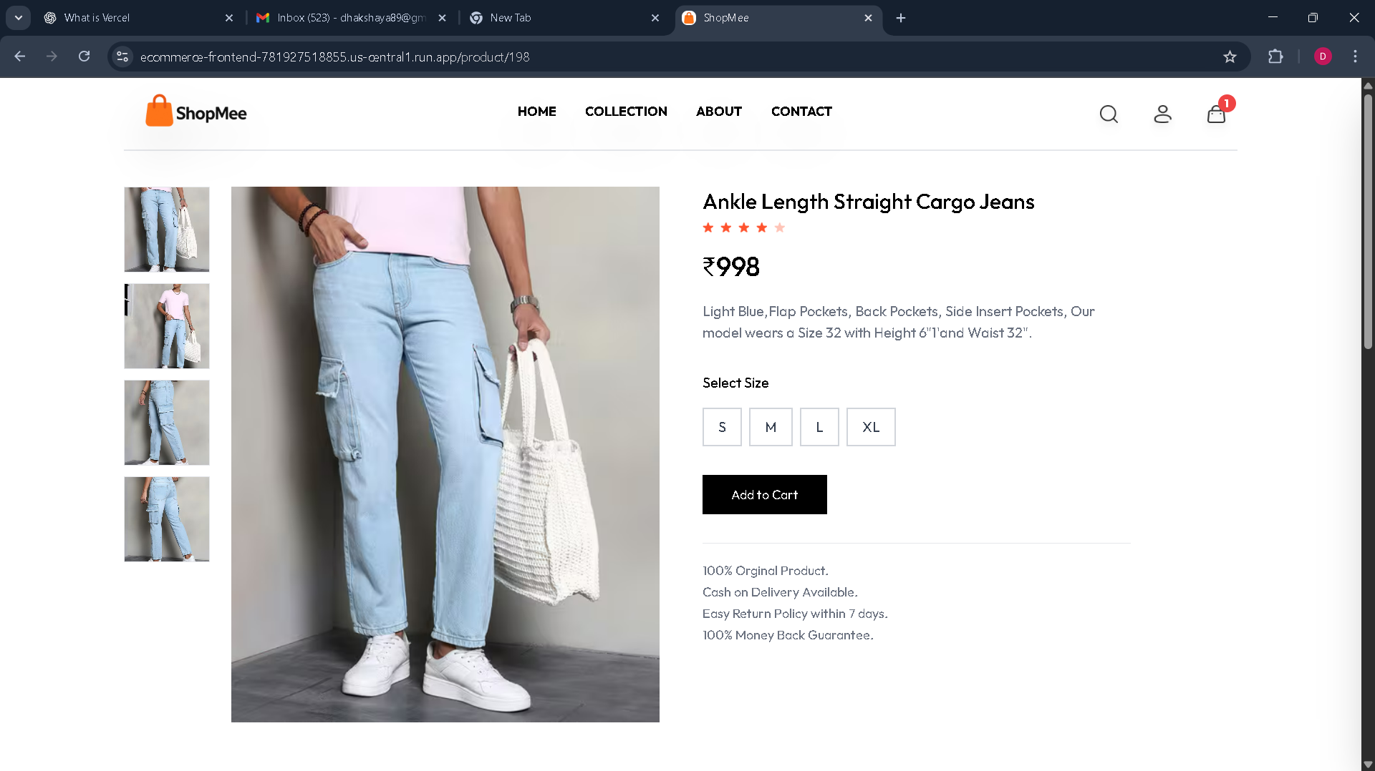
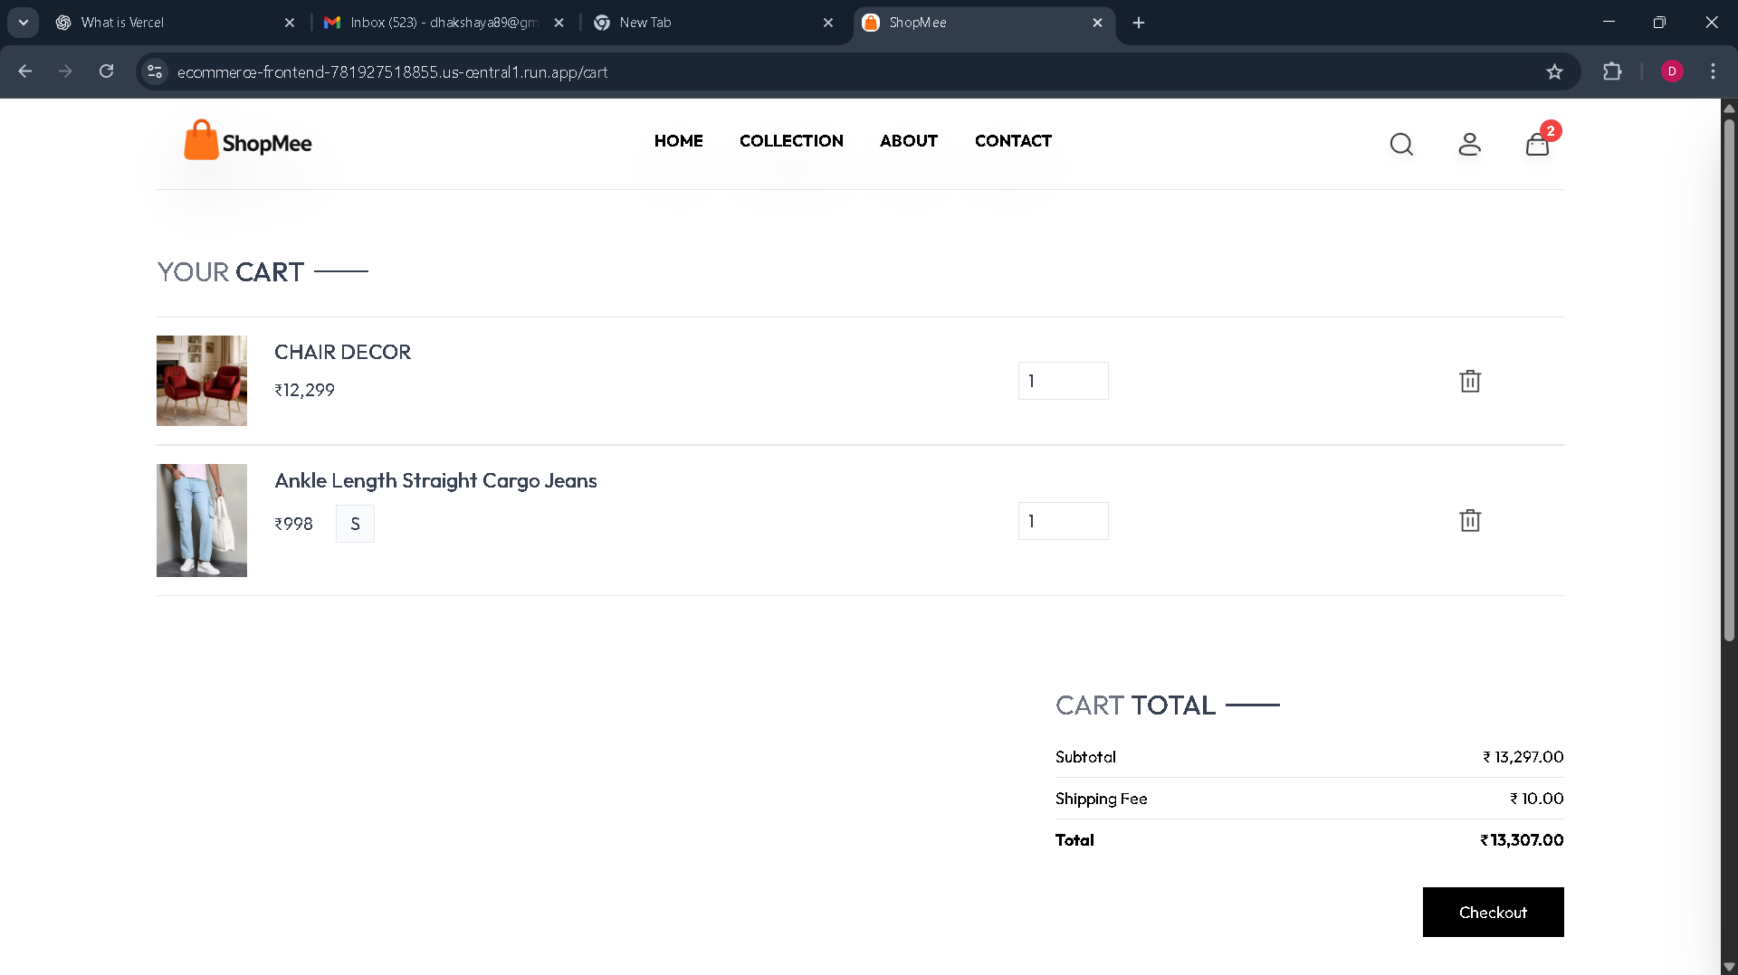
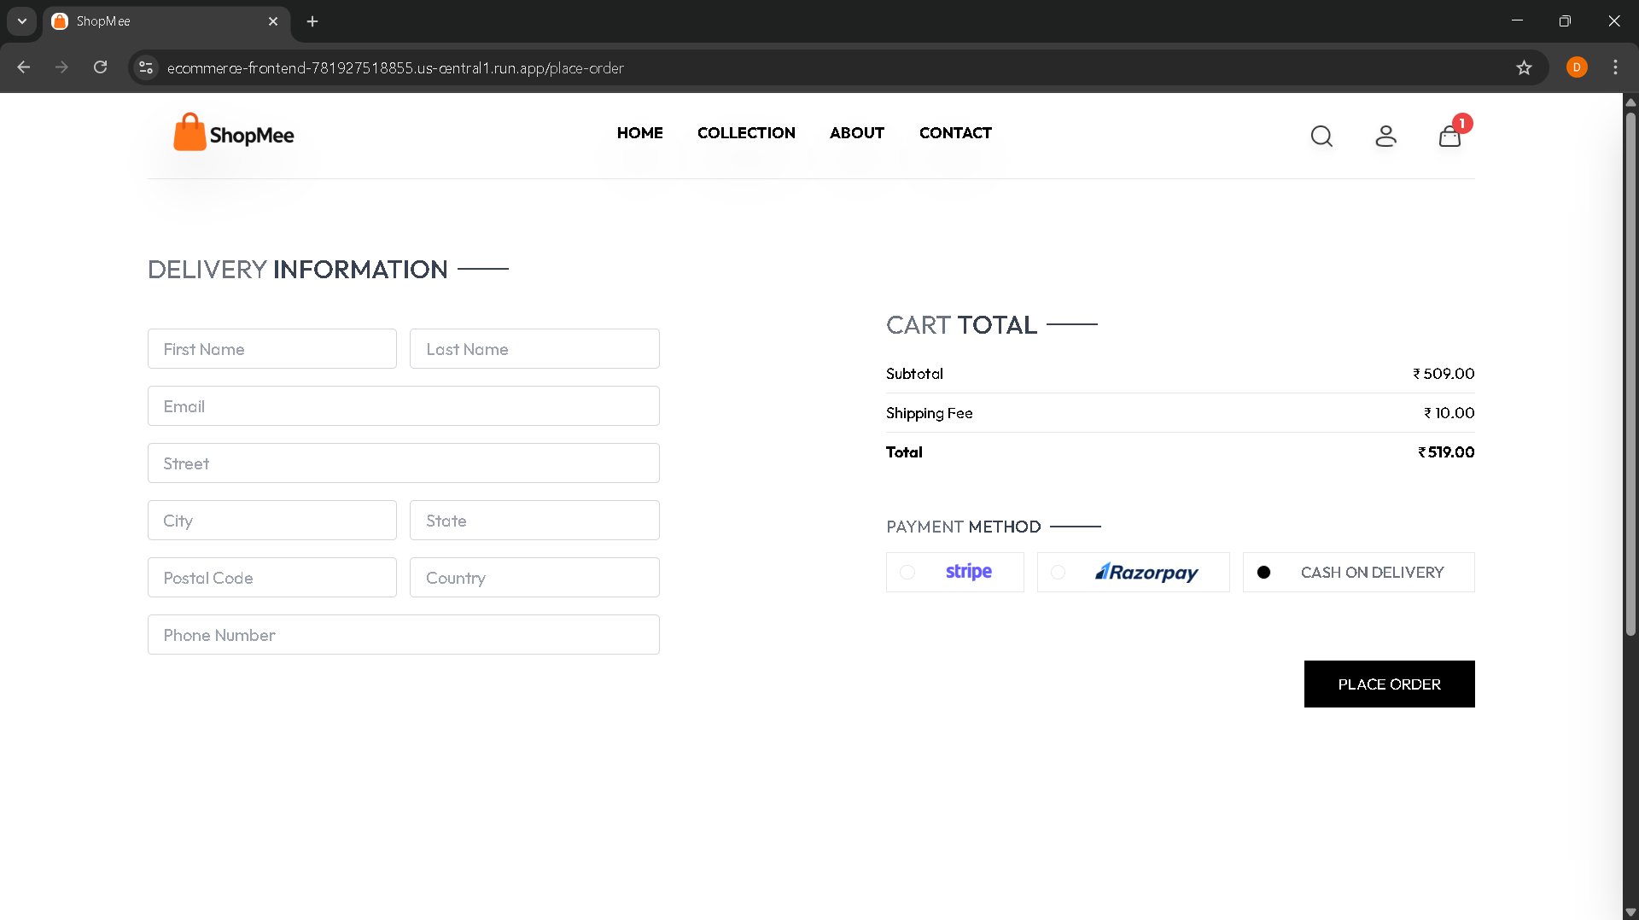
Frontend Screenshots
Home Page
Products Page
Cart Page
Place-Order Page

Slide 13
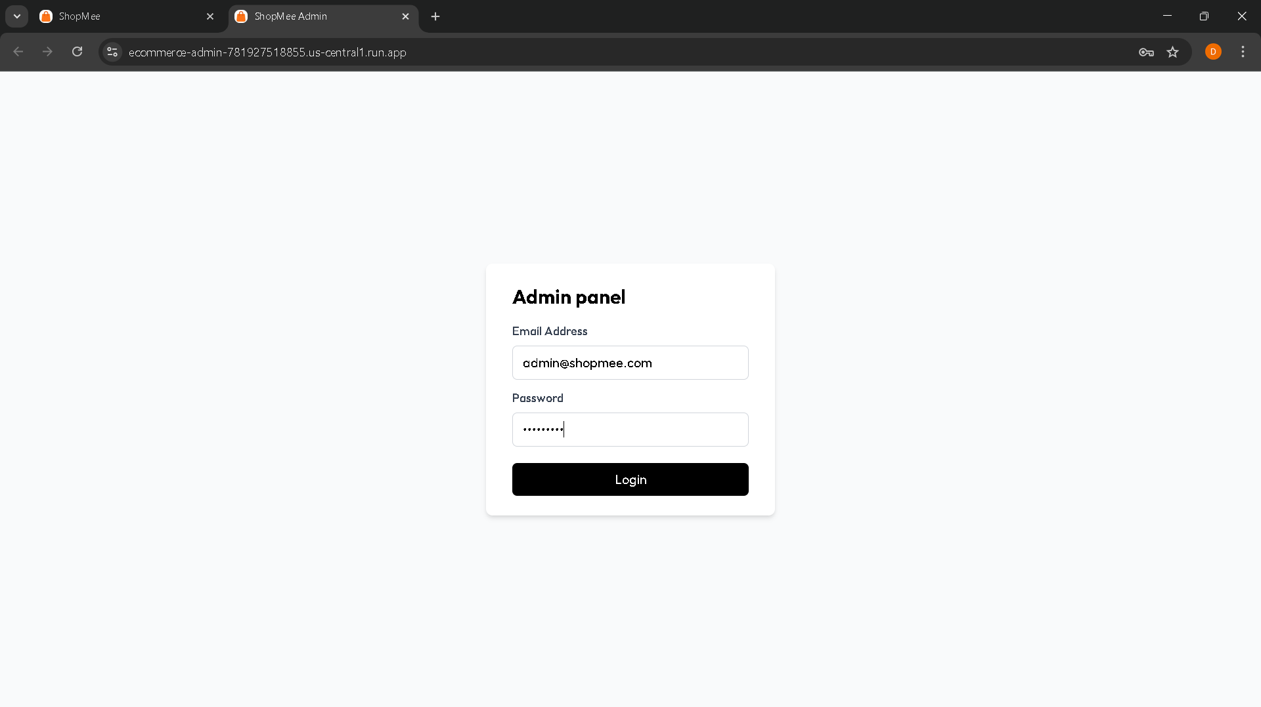
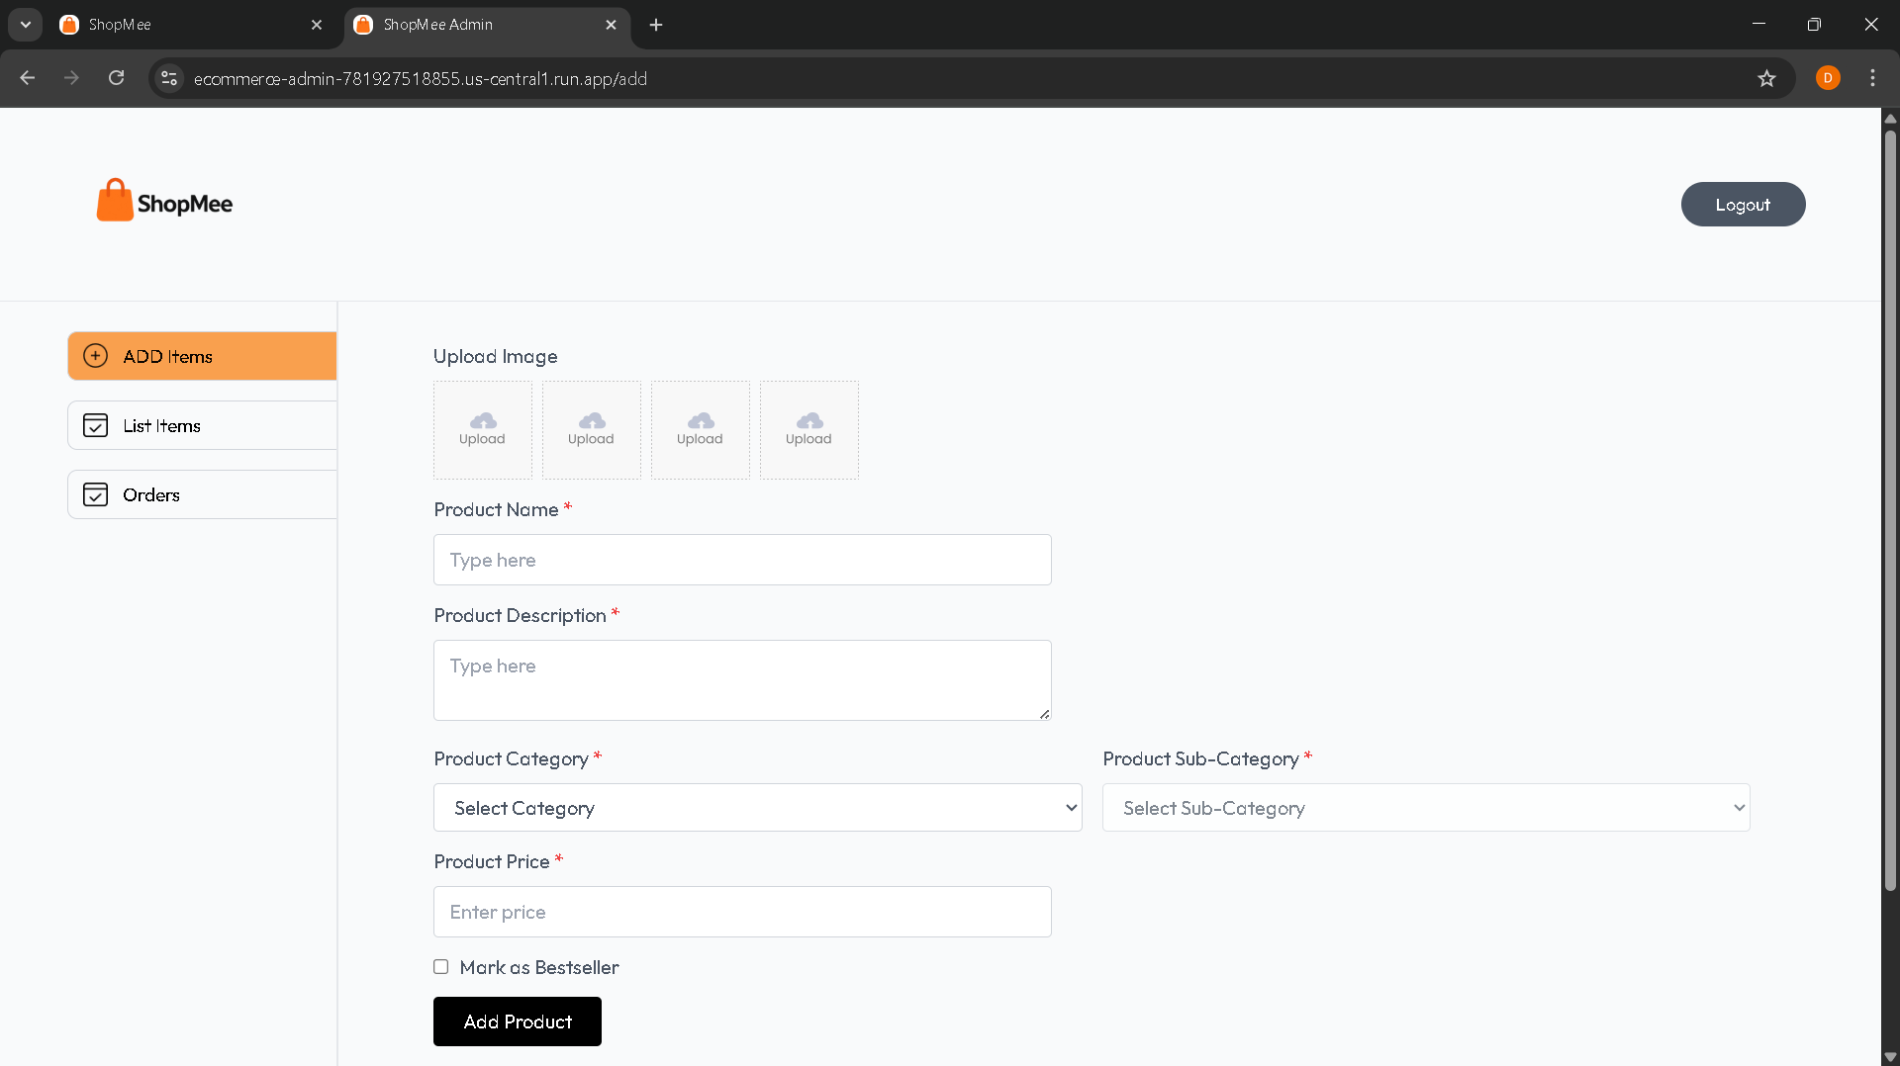
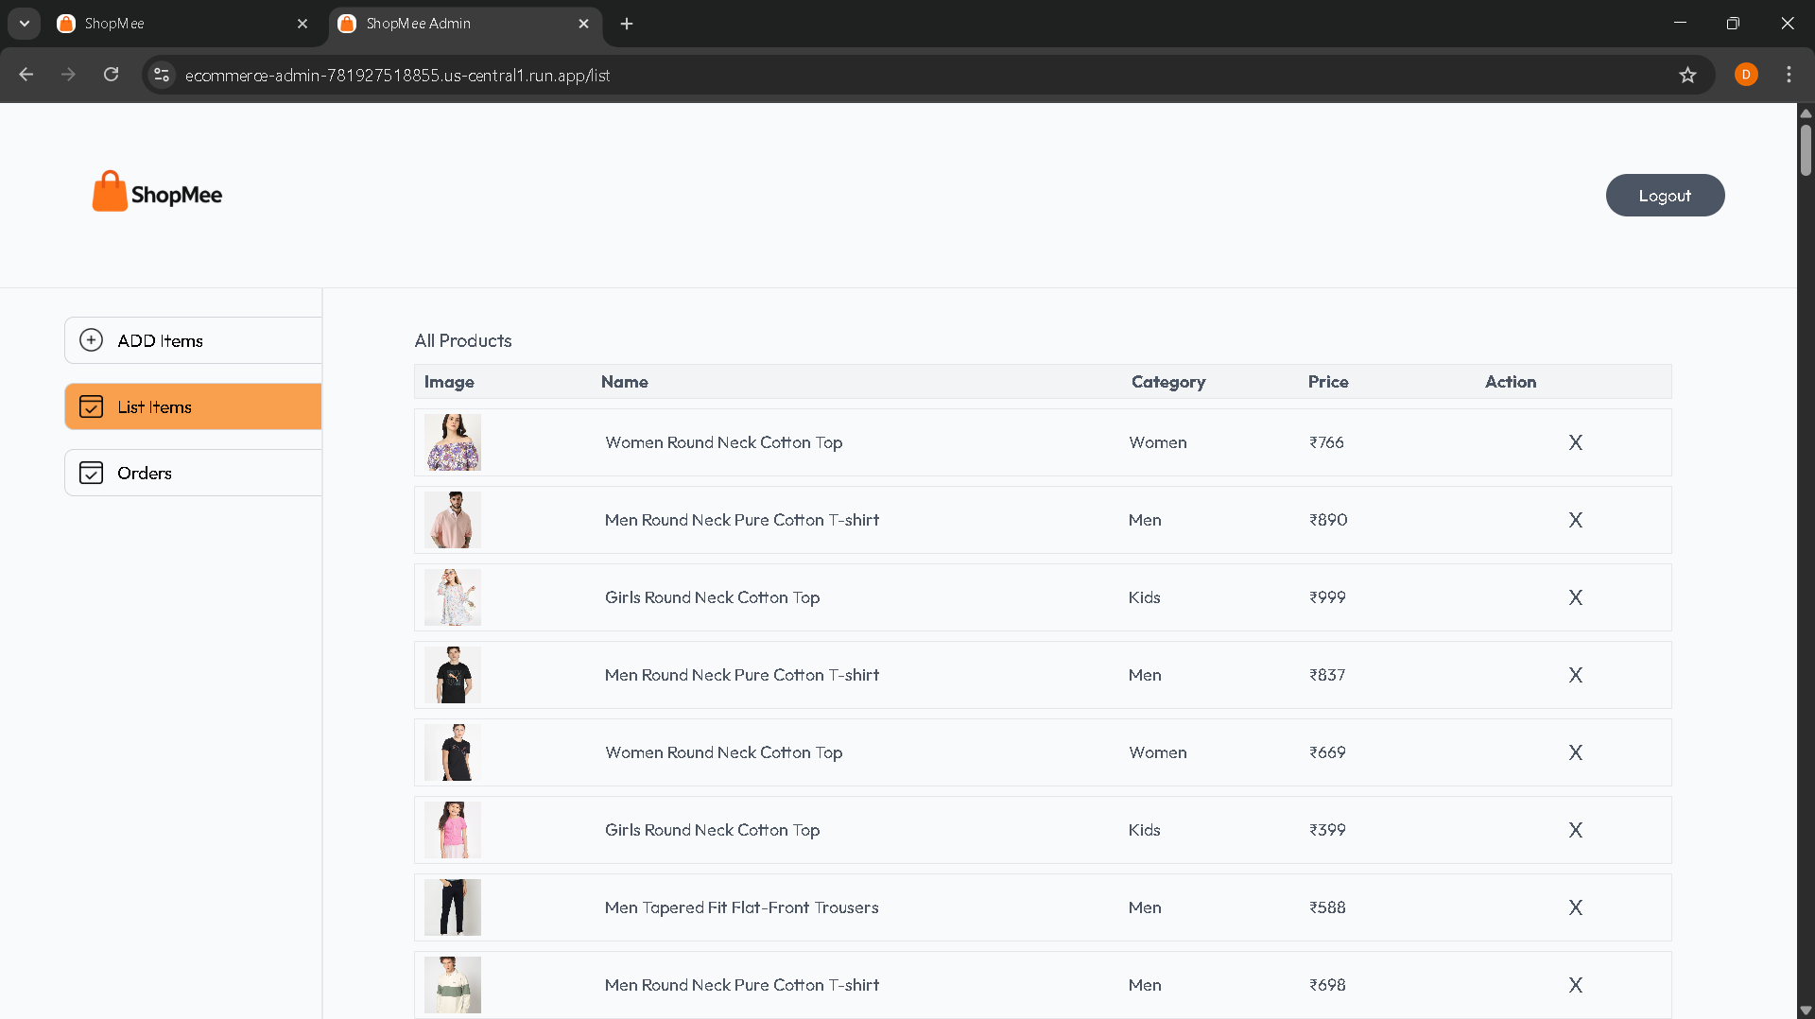
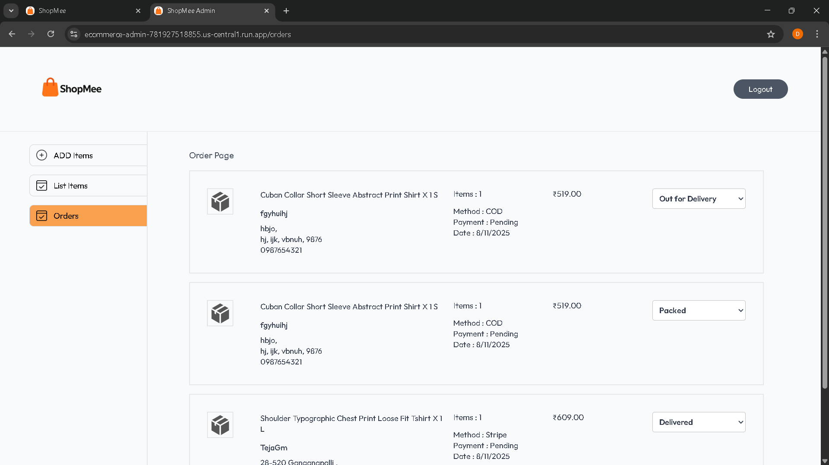
Admin Screenshots
Admin Login Page
Add Products Page
Products List Page
Order Page

Slide 14
DEMO Links
Backend Link: https://ecommerce-backend-781927518855.us-central1.run.app
Admin Link: https://ecommerce-admin-781927518855.us-central1.run.app
Frontend Link: https://ecommerce-frontend-781927518855.us-central1.run.app
Run Demo
Thank You

